Slide 1
Final project: pet adoption analysis
Presenter: Sheree Harris
Instructor: Shashi Bhushan Jha, Ph.D.
Course: CAP4770 Data Mining

Slide 2
Problem Statement
This project aims to predict which pets are likely to get adopted based on factors like type, breed, color, condition, sex, and why the pet was at the shelter. I hope to identify the characteristics linked to quicker adoptions, providing insight that shelters could use to prioritize resources to improve the appeal of certain types of pets. For this project, I will focus on the intake and outtake data for animals at the Austin Animal Shelter.

Slide 3
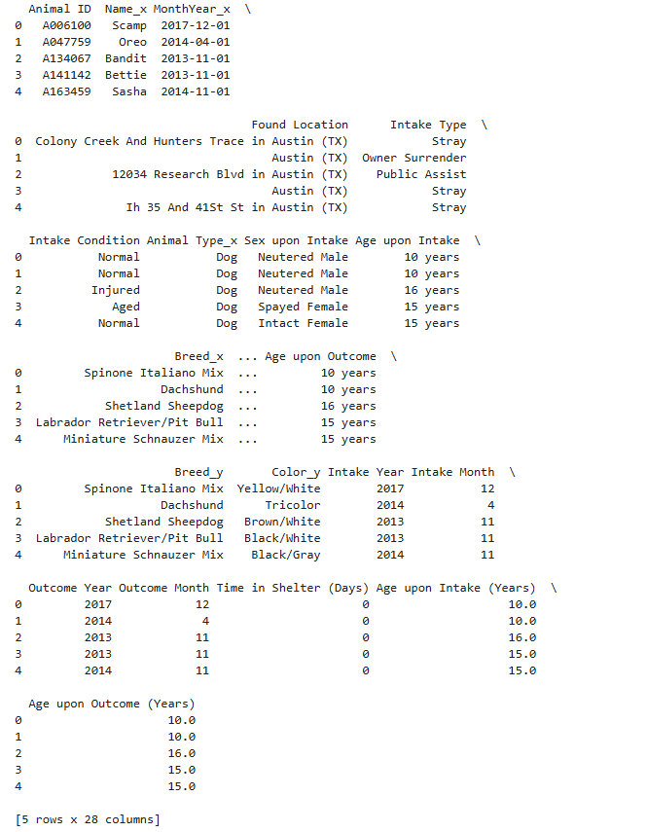
Data collection & preprocessing
Created a database in MySQL and ingest two datasets
Austin Animal Intakes
Austin Animal Outtakes
In Notebook, preprocessed data
Connected to MySQL to pull and clean data
Joined tables, standardized columns, dropped duplicates

Slide 4
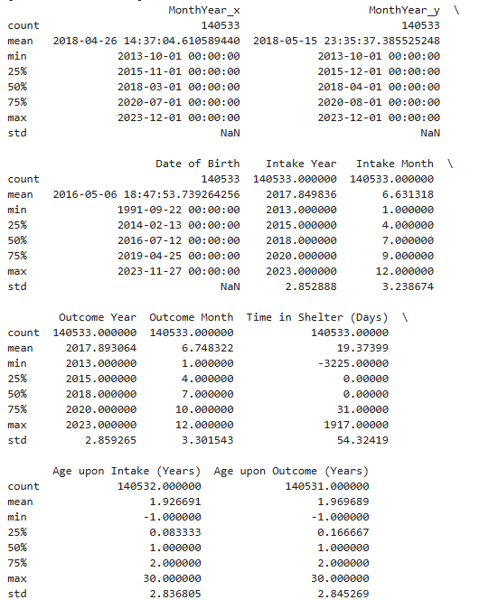
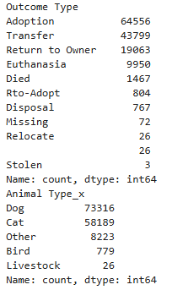
Data analysis
Look at the data in different ways in order to find trends, correlations, and other factors
Statistical Summary
Trends
Influencing Factors
Time-based Factors

Slide 5
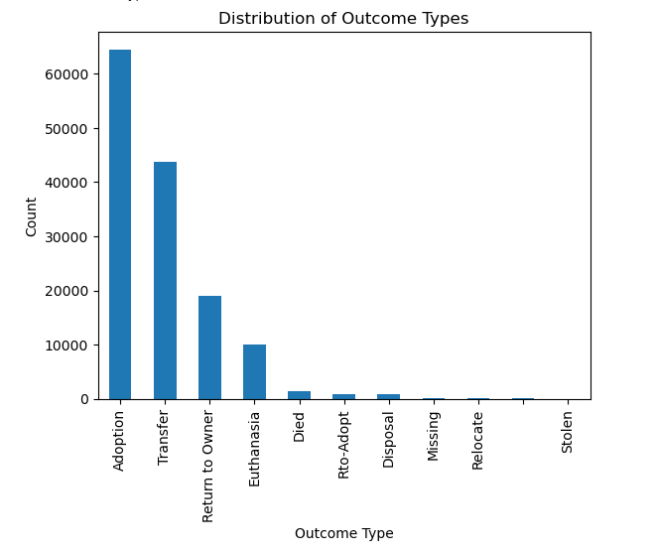
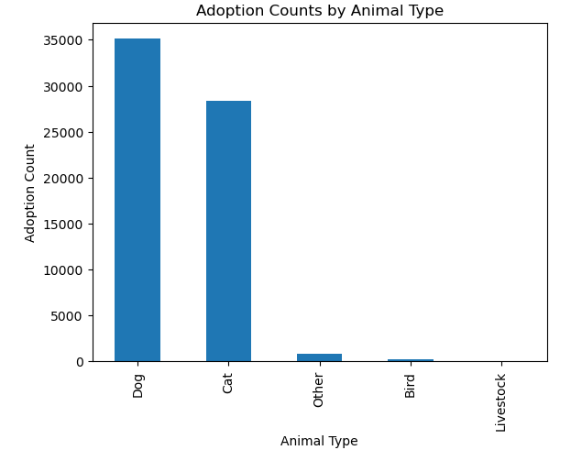
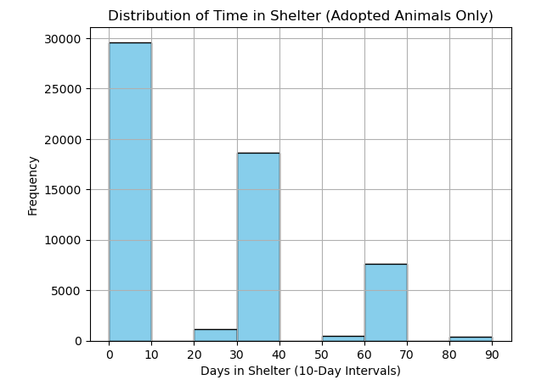
Data analysis
Look at the data in different ways in order to find trends, correlations, and other factors
Statistical Summary
Trends
Influencing Factors
Time-based Factors

Slide 6
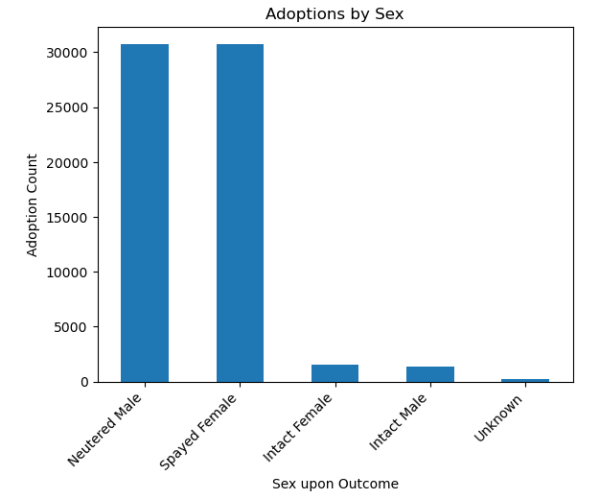
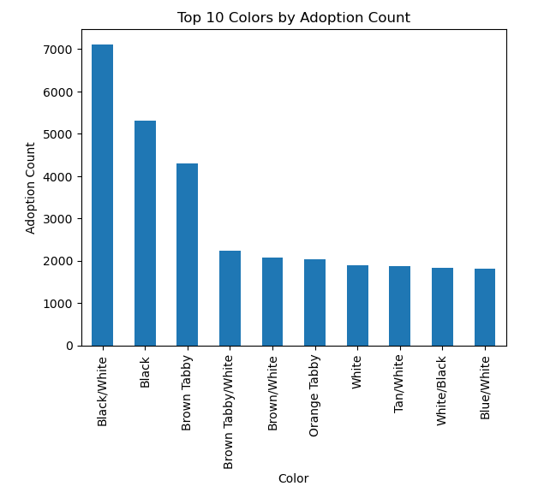
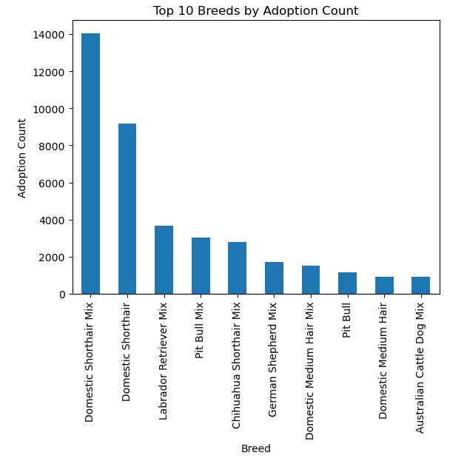
Data analysis
Look at the data in different ways in order to find trends, correlations, and other factors
Statistical Summary
Trends
Influencing Factors
Time-based Factors

Slide 7
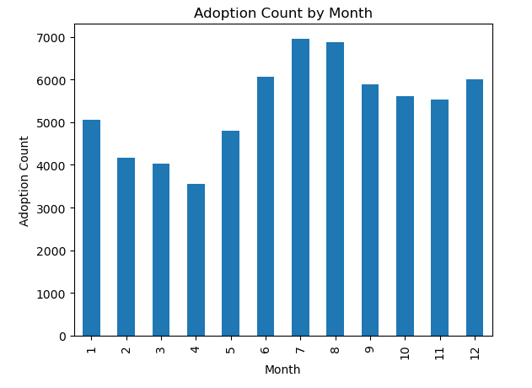
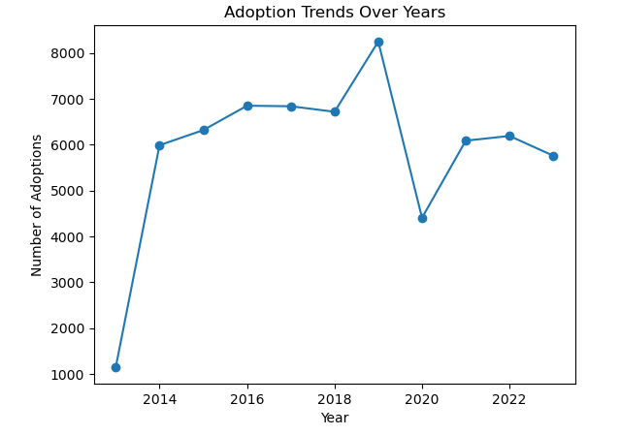
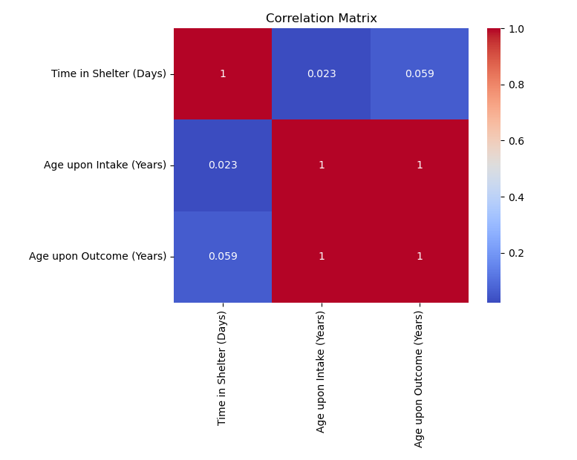
Data analysis
Look at the data in different ways in order to find trends, correlations, and other factors
Statistical Summary
Trends
Influencing Factors
Time-based Factors

Slide 8
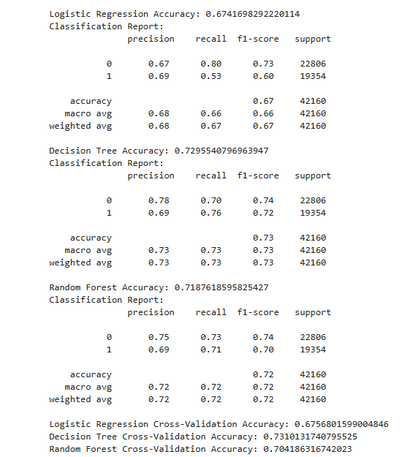
Prediction modeling
Tested/trained three different prediction models in order to find most accurate method
Logistic Regression
Decision Tree Classifier
Random Forest Classifier
Of the three models used, Decision Tree Classifier had the highest accuracy after cross-validation with a score of 0.731

Slide 9
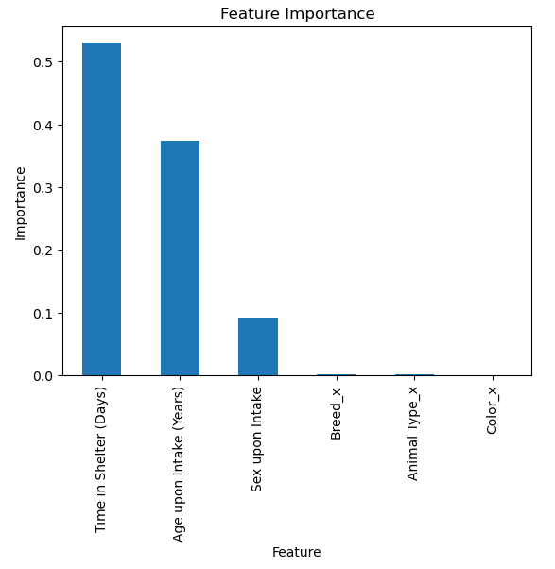
Insights after analysis
Use the Decision Tree Classifier and discover the most important features
Compare the top features with the trends found during Data Analysis
Provide the gained insights and possible solutions to shelters
By combing the results from the Data Analysis, which show adopter preferences; with the model showing the shelter’s efficiency some possible solutions are
Use the Data Analysis results, focusing on the more popular breeds and colors, for marketing purposes.
Use the prediction model results, which focus on age and time in shelter, to conduct targeted campaigns

Slide 10

Questions? Data Sets used: Austin Animal center data located on Kaggle @: https://www.kaggle.com/datasets/thedevastator/austin-animal-center-data?resource=download&select=Austin+Animal+Center+Intakes

